Slide 1
Welcome to today’s
FDA/CDRH Webinar
Thank you for your patience while additional time is provided for participants to join the call.
If you have not connected to the audio portion of the webinar, please do so now:
U.S. Dial: 888-455-1392
Passcode: 8746836
International Dial: 773-799-3847
Passcode: 8746836

Slide 2
Remanufacturing of Medical Devices Draft Guidance and Strengthening Cybersecurity Practices Associated with Servicing of Medical Devices Discussion Paper
Katelyn Bittleman
Policy Analyst
Compliance and Quality Staff
Josh Silverstein
Regulatory Advisor
Regulation, Policy, and Guidance Staff
Office of Product Evaluation and Quality
Center for Devices and Radiological Health
July 27, 2021

Slide 3
Agenda
Objectives
Background
Summary of Remanufacturing Draft Guidance
Summary of Cybersecurity and Servicing Discussion Paper
Questions and Answers

Slide 4
Objectives
Remanufacturing of Medical Devices Draft Guidance
  Why the FDA is clarifying which activities are likely remanufacturing
  How the FDA proposes that entities analyze whether their activities are likely remanufacturing
  What information manufacturers should include in the labeling for reusable devices that are serviced
  How entities should document their rationale about whether their activities are remanufacturing
Strengthening Cybersecurity Practices Associated with Servicing of Medical Devices Discussion Paper
  Cybersecurity is a shared responsibility between all stakeholders
  The FDA has outlined cybersecurity challenges and opportunities associated with medical device servicing and is seeking stakeholder feedback to inform future efforts

Slide 5
Background
The FDA has been working to gain additional perspectives on the distinction between “servicing” and “remanufacturing” and has undertaken several efforts to help promote clarity
In the FDA Report on Device Servicing, the FDA concluded that a majority of the comments, complaints, and adverse event reports received by the FDA that referred to inadequate “servicing” causing or contributing to adverse events and deaths actually related to “remanufacturing”
Whether the activities an entity performs are remanufacturing affects the applicability and enforcement of regulatory requirements by the FDA. The FDA has consistently enforced requirements on entities engaged in remanufacturing
The FDA released a white paper, opened a docket, and held a public workshop to facilitate discussion on the distinction between servicing and remanufacturing

Slide 6
Background
The Remanufacturing draft guidance is not intended to adopt significant policy changes, but to clarify the FDA’s current thinking on applicable definitions, and clarify, not change, the regulatory requirements applicable to remanufacturers
The Remanufacturing guidance is a draft guidance. The FDA is requesting public comment. It is not for implementation until the FDA issues a final guidance
Cybersecurity is a widespread issue affecting medical devices connected to the Internet, networks, and other devices. In the FDA Report on Device Servicing, the FDA also committed to strengthening cybersecurity practices associated with the servicing of medical devices

Slide 7
Definitions
Intended use
The general purpose of the device or its function, which encompasses the indications for use
A manufacturer is any person who designs, manufactures, fabricates, assembles, or processes a finished device. A remanufacturer is any person who processes, conditions, renovates, repackages, restores, or does any other act to a finished device that significantly changes the finished device’s performance or safety specifications, or intended use. The FDA considers remanufacturers to be manufacturers. For electronic products, a manufacturer is any person engaged in the business of manufacturing, assembling, or importing electronic products
Performance specifications
The performance characteristics of a device established by the OEM for the device to perform as intended, including those listed in device labeling or in finished product release specifications. Some examples include measurement accuracy, output accuracy, energy output level, and stability criteria
Manufacturers (Manufacturers, Original Equipment Manufacturers (OEMs), or Remanufacturers)

Slide 8
Definitions
Recondition, Refurbish or Rebuild
Restores a medical device to the OEM’s original specifications or to be “like new.” The device may be brought to current specifications if the changes made to the device do not significantly change the finished device’s performance or safety specifications, or intended use. These activities include repair of components, installation of OEM provided updates and upgrades, and replacement of worn parts
Remanufacture
Process, condition, renovate, repackage, restore, or any other act done to a finished device that significantly changes the finished device’s performance or safety specifications, or intended use
A type of servicing that returns a component to original specifications, including replacing non-working components or parts outside of routine or periodic upkeep for the current owner of the device
Repair

Slide 9
Definitions
Reprocessing
With respect to reusable devices, means validated processes used to render a medical device, which has been previously used or contaminated, fit for a subsequent single use on a patient. These processes are designed to remove soil and contaminants by cleaning and to inactivate microorganisms by disinfection or sterilization
Safety specifications
The safety characteristics of a device established by the OEM for the safe use of the device, including those incorporated into the device design and finished product release specifications, generally including the device’s compensating controls and risk mitigations. Some examples include alarms, sensors, and locking or fail-safe mechanisms
Service
Repair and preventive or routine maintenance of one or more parts in a finished device, after distribution, for purposes of returning it to the safety and performance specifications established by the OEM and to meet its original intended use. Servicing excludes activities that significantly change the finished device’s safety or performance specifications, or intended use
Third party servicers and Independent Service Organizations (ISOs)
Entities, other than the OEM or healthcare delivery organizations, that maintain, restore, refurbish, or repair a finished device after distribution, for purposes of returning it to the safety and performance specifications established by the OEM and to meet its original intended use

Slide 10
Scope
Intended to be reused and maintained
Including software and electronic products that are devices
Focused on activities by OEMs and third parties on devices that are likely remanufacturing
Does not include reprocessed single-use devices
Irrespective of class I, II, or III, including those subject to premarket approval
Devices

Slide 11
Guiding Principles
Assess whether there is a change to the intended use
Determine whether the activities, individually and cumulatively, significantly change the safety or performance specifications of a finished device
Evaluate whether any changes to a device require a new marketing submission
Assess component, part, or material dimensional and performance specifications
5. Employ a risk-based approach
6. Adequately document decision-making

Slide 12
Relevant considerations to determine if activities are remanufacturing
Significant change to device performance or safety specifications is one that, based on verification and validation testing and a risk-based assessment, results in a finished device that is outside the OEM’s performance or safety specifications or introduces new risks or significantly modifies existing risks
The FDA has identified certain types of activities that, in general, the FDA believes significantly change the legally marketed device’s performance or safety specifications:
  Changes to the device’s sterilization methods
  Changes to the device’s reprocessing instructions
  Changes to the device’s control mechanism, operating principle, or energy type
Remanufacturing includes significant changes to a device’s intended use

Slide 13
Relevant considerations to determine if activities are remanufacturing
For activities involving components, parts, and materials, the FDA recommends the use of a flowchart
  The FDA does not recommend evaluation with flowchart when an activity is performed on behalf of, or otherwise explicitly authorized by, the OEM and the activity returns the legally marketed device to its original performance and safety specifications, and intended use
Although definitions and guiding principles apply to software, the flowchart should not be applied to software
Entities performing activities on devices should make a determination about whether each activity and the cumulative effects of such activities are remanufacturing and document their rationale.
  The documentation should be prepared in a way that an FDA investigator or other third party can understand what the change was and the rationale underlying the conclusion
  Guidance includes minimum documentation recommendations, including product name, dates, descriptions of device and activities, whether the activity is remanufacturing, references to related documents, and signatures

Slide 14
Flowchart to help determine whether activities performed are likely remanufacturing
As a reminder, this flowchart is:
  Intended to be used after an entity determines that there is no significant change to intended use or the device’s sterilization methods, reprocessing instructions, control mechanism, operating principle, or energy type
  Provided as a visual aid, but does not capture all relevant considerations
Refer to the accompanying text in guidance when using the flowchart
Assessment
Objective decision

Slide 15
How to Determine if Activities are Likely Remanufacturing
[Continue to A2]

Slide 16
How to Determine if Activities are Likely Remanufacturing
[Continue to A3]

Slide 17
How to Determine if Activities are Likely Remanufacturing

Slide 18
Changes Involving Software
Flowchart should not be used for changes involving software
Many software changes are likely remanufacturing:
  Impact on software architecture, software requirements specifications, unresolved anomalies, and other key characteristics
  Probability of software failure cannot be determined using traditional statistical methods
The FDA has identified certain activities performed on software that are likely not remanufacturing
Unintended consequences and cumulative effects of any software changes should be evaluated
If an entity believes that a software change is not remanufacturing, they should adequately document their decision-making

Slide 19
Software activities that are likely not remanufacturing
Activities performed on behalf of or otherwise explicitly authorized by the OEM that return the legally marketed device to its performance and safety specifications, and intended use
Turning on or off connectivity features (for example, Wi-Fi and Bluetooth connections) consistent with OEM intended use
Implementing OEM provided updates and upgrades
Performing data backup and recovery operations
Running software-based hardware diagnostics
Assessing software inventory
Assessing for viruses, malware, and other cybersecurity related issues
Collecting system logs
Reinstalling OEM software to restore original performance and safety specifications
Managing user accounts
Reverting software to a previous configuration
Accessing diagnostic and repair information
Installing cybersecurity updates that are authorized by the OEM

Slide 20
Considerations for Labeling
The FDA believes that OEMs of reusable devices intend for their devices to routinely undergo both preventive maintenance and repair. It is important that such devices include instructions on how to adequately return a device to its performance and safety specifications established by the OEM
Unintentional remanufacturing can occur when entities do not have the instructions necessary to return a device to its original performance and safety specifications
The lack of adequate servicing instructions can also create challenges in the availability of quality, safe, and effective devices
Consistent with promoting and protecting the public health, the FDA encourages OEMs, as an industry best practice, to provide servicing instructions that facilitate routine maintenance and repair of their reusable devices

Slide 21
What OEMs should include in reusable device labeling to facilitate routine maintenance and repair
A description of the key performance and safety specifications
Critical technical or functional specifications, including:
Physical dimensions
Electrical characteristics, including batteries (for example, chemistry, amperage, voltage, and rechargeability), internal fuses, and power supply (for example, voltage, amperage, and frequency)
Device-specific performance specifications (for example, flow rate accuracy or range, humidity, temperature, and wavelength)
The recommended maintenance activities and schedule
Recommended routine testing and acceptance criteria to confirm that the device remains within its performance and safety specifications
A description of error codes, alerts, and alarm features on the device
Precautions and warnings relevant to servicing the device
Version number and release date of software

Slide 22
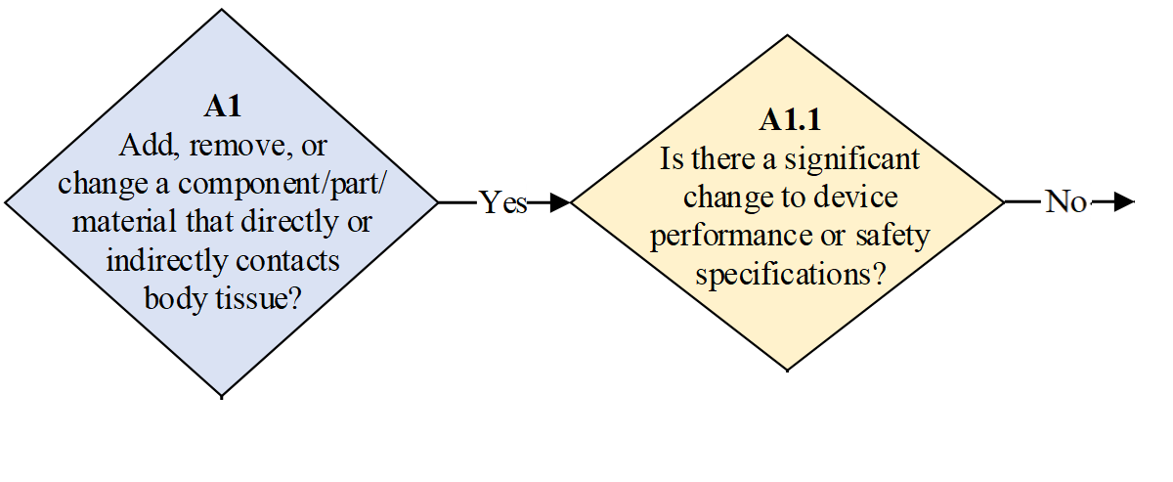
Example E8.a.
Activity: The lens of an endoscope is cracked. The lens is affixed by an epoxy that is not described in the labeling. The cracked lens was removed and replaced. The epoxy used was purchased from the OEM and is identical to that used in the legally marketed device. The replacement lens was not purchased from the OEM. The lens was tested and demonstrated to have the same optical specifications (for example, focal length and Abbe number) and materials as the original lens.

Slide 23
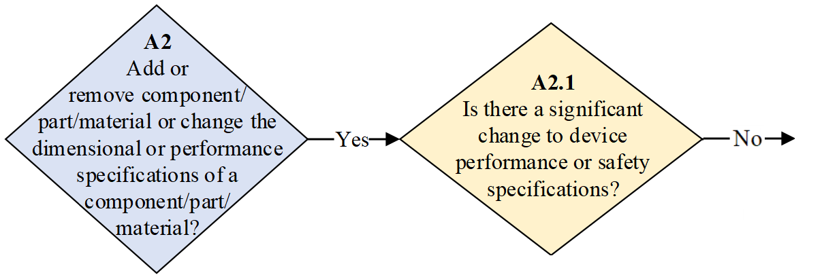
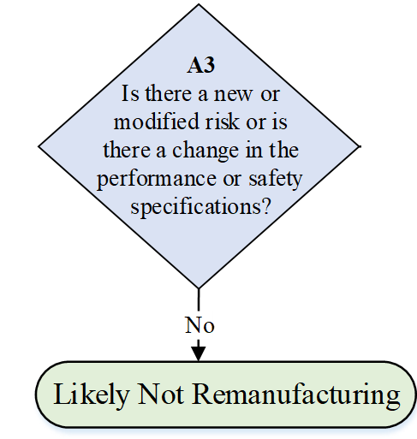
Example E8.a.

Slide 24
Example E8.b.
Activity: The lens of an endoscope is cracked. The lens is affixed by an epoxy that is not described in the labeling. The cracked lens was removed and replaced. The epoxy used was purchased from the OEM and is identical to that used in the legally marketed device. The replacement lens comes from a different endoscope model from the same OEM; that model was 510(k)-cleared with improved optical performance (for example, resolution and distortion) relative to the original endoscope. The replacement lens has the same material but different optical specifications (for example, focal length and Abbe number) from the original.

Slide 25
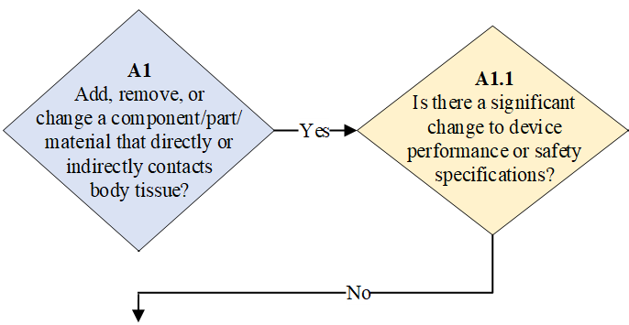

Example E8.b.

Slide 26
Example S2
Activity: A device has the capability of real-time remote customer service where the current status of the device can be accessed. A capability is added so that the customer service technician can access and directly manipulate the device, including changing device settings, resetting the device, delivering energy, and positioning the device
Relevant analysis: The capability of the customer service technician to control the device introduces new risks (for example, accidental device reset and unintended device movement) and functionality (remote control and access) that significantly changes the finished device’s performance and safety specifications
Decision: Remanufacturing

Slide 27
Strengthening Cybersecurity in the
Servicing of Devices
The FDA released a discussion paper to discuss cybersecurity issues unique to the servicing of medical devices to guide stakeholder discussions
Scope:
    Includes devices serviced by non-OEMs
    Does not include remanufacturing
Cybersecurity is a shared responsibility among all stakeholders
  The FDA expects manufacturers to appropriately secure their devices in order to continue to assure the devices’ safety and effectiveness
  Non-OEM servicing entities play an important role in maintaining the quality, safety, and efficacy of medical devices without compromising cybersecurity

Slide 28
Strengthening Cybersecurity in the
Servicing of Devices
Challenges and Opportunities
  Privileged access
  Identification of Cybersecurity Vulnerabilities and Incidents
  Prevention and Mitigation of Cybersecurity Vulnerabilities
  Product Life Cycle Challenges and Opportunities
Feedback requested to the docket
  Cybersecurity challenges and opportunities in servicing
  Priority areas to address
  How can servicing entities strengthen the cybersecurity of medical devices

Slide 29
Stakeholder Feedback Requested
Please submit comments to the public dockets:
  Draft Guidance: Remanufacturing of Medical Devices*
    By August 23, 2021 to FDA-2018-N-3741
  Discussion Paper: Strengthening Cybersecurity Practices Associated with Servicing of Medical Devices: Challenges and Opportunities
    By August 17, 2021 to FDA-2021-N-0561
  *Although you can comment on any guidance at any time (see 21 CFR 10.115(g)(5)), to ensure that the FDA considers your comment on a draft guidance before it begins work on the final guidance, submit comments on the draft guidance before the comment period closure date.

Slide 30
Resources
Draft Guidance: Remanufacturing of Medical Devices
Discussion Paper: Strengthening Cybersecurity Practices Associated with Servicing of Medical Devices: Challenges and Opportunities
Device Advice: Remanufacturing and Servicing Medical Devices
FDA Report on the Quality, Safety, and Effectiveness of Servicing of Medical Devices

Slide 31
Questions?
Division of Industry and Consumer Education: DICE@fda.hhs.gov
Slide Presentation, Transcript and Webinar Recording will be available at:
http://www.fda.gov/training/cdrhlearn
Under Heading: Post Market Activities; Sub-heading: General Policy
Please complete a short survey about your FDA CDRH webinar experience. The survey can be found here
immediately following the conclusion of the live webinar

