Slide 1
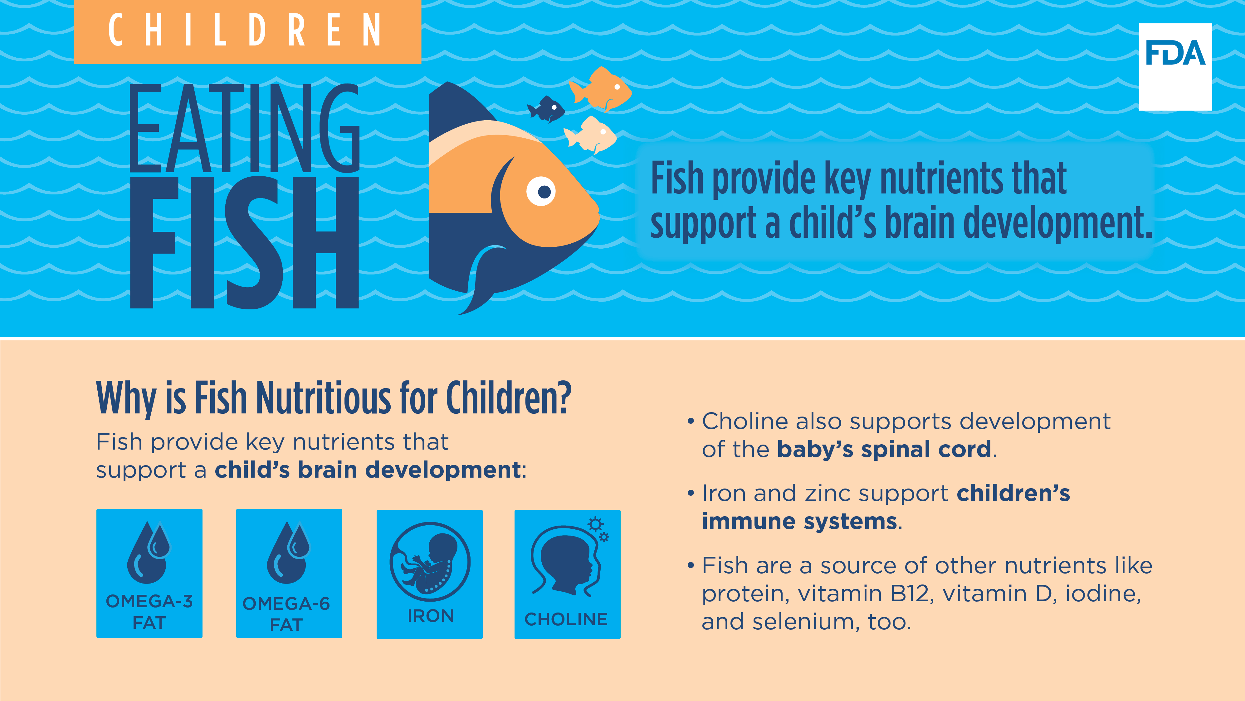
CHILDREN EATING FISH
Fish provide key nutrients that support a child’s brain development.
Why is Fish Nutritious for Children?
Fish provide key nutrients that support a child’s brain development:
OMEGA-3 FAT
OMEGA-6 FAT
IRON - Iron and zinc support children’s immune systems.
CHOLINE - Choline also supports development of the baby’s spinal cord.
IODINE - Fish are a source of other nutrients like protein, vitamin B12, vitamin D, iodine, and selenium, too.
Notes:
FDA and EPA have issued advice regarding eating fish to help those who might become or are pregnant or breastfeeding as well as parents and caregivers who are feeding children make informed choices when it comes to the types of fish that are nutritious and safe to eat.
FDA recommends eating fish as part of a healthy diet and encourages children to eat fish that are lower in mercury.
Fish provide key nutrients to support a child’s brain development, such as omega-3 and omega-6 fats, iron, and choline. Choline also supports development of the baby’s spinal cord. Fish provide iron and zinc to support children’s immune systems and are a source of other nutrients like protein, vitamin B12, vitamin D, and selenium too.

Slide 2
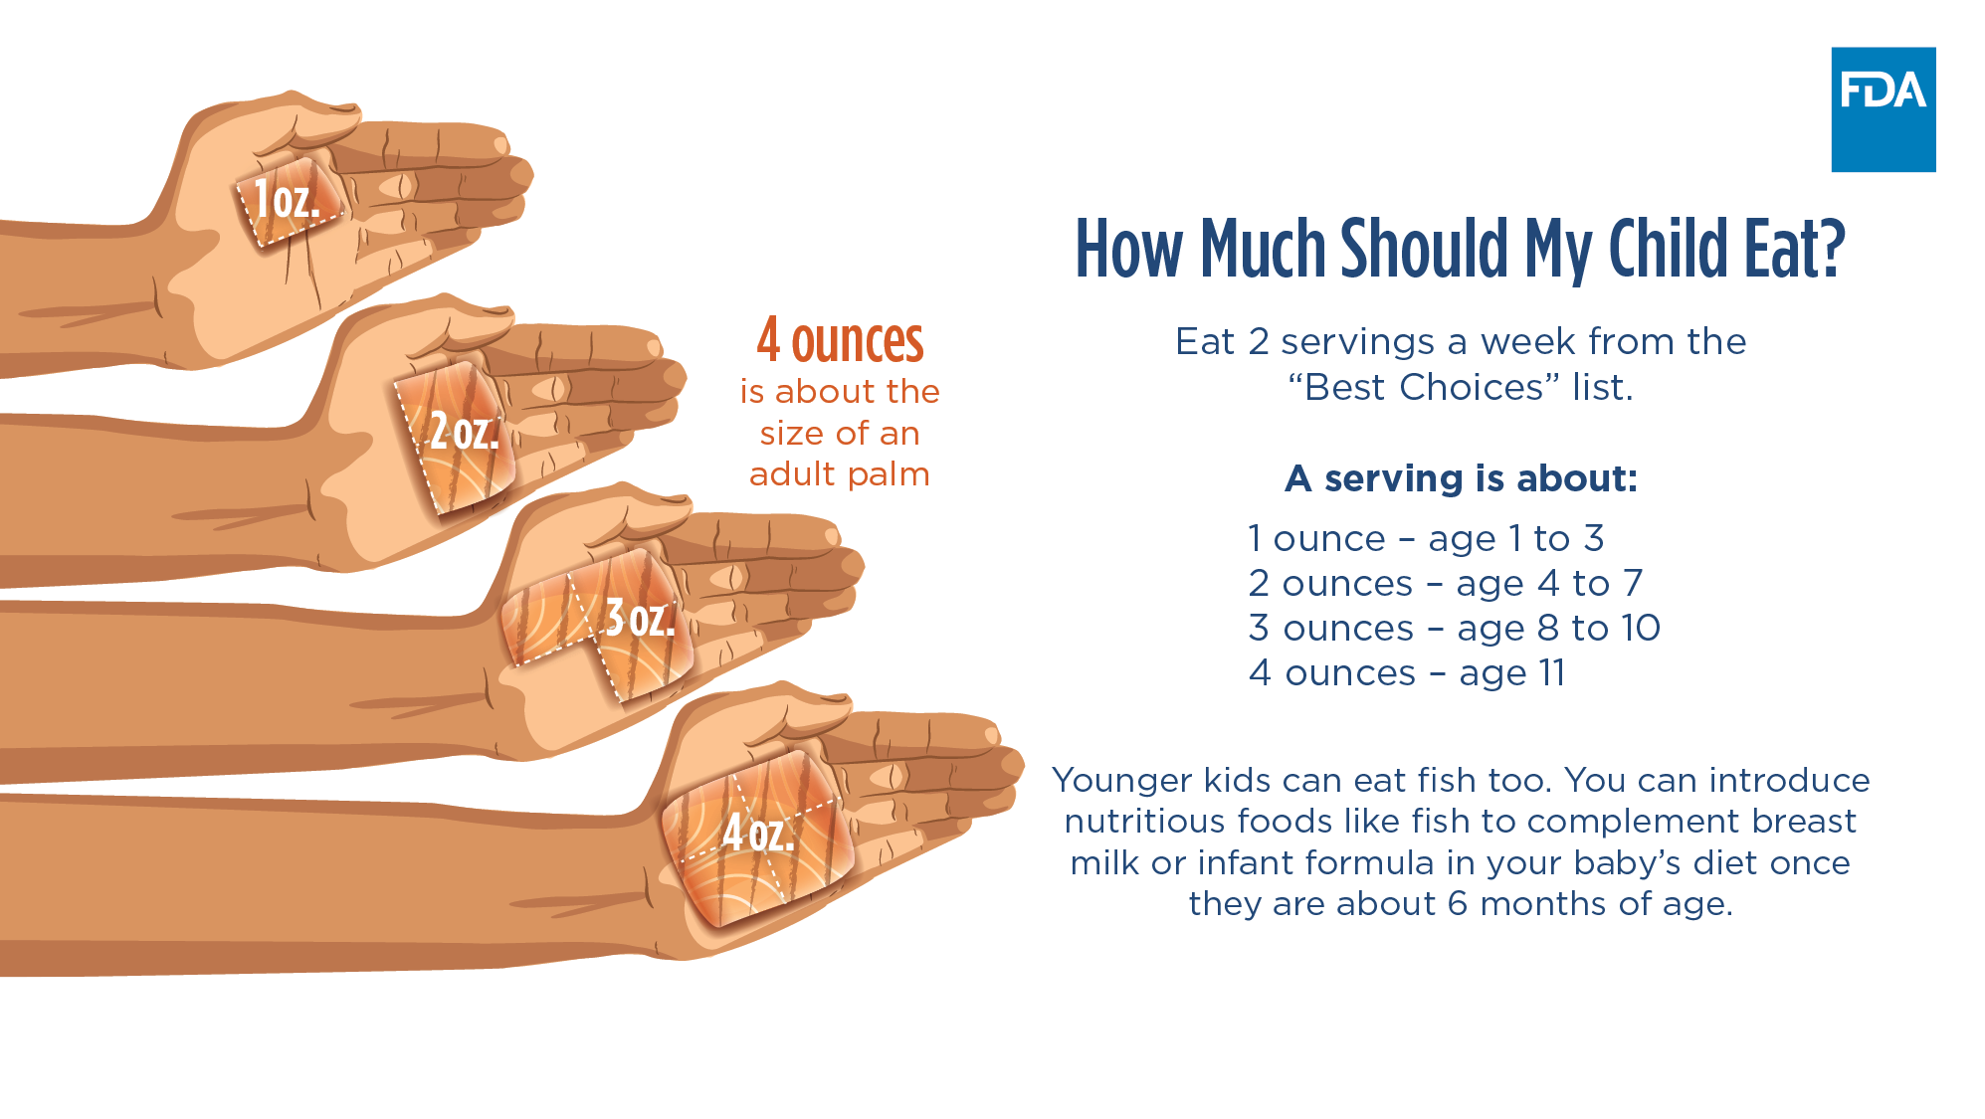
How Much Should My Child Eat?
Eat 2 servings a week from the “Best Choices” list.
A serving is about:
1 ounce – age 1 to 3
2 ounces – age 4 to 7
3 ounces – age 8 to 10
4 ounces – age 11
Younger kids can eat fish too. You can introduce nutritious foods like fish to complement breast milk or infant formula in your baby’s diet once they are about 6 months of age.
Notes:
According to the Dietary Guidelines for Americans, you can introduce nutritious foods like fish to complement breast milk or infant formula in your baby’s diet once they are about 6 months of age.
FDA recommends children eat 2 servings of fish a week from FDA and EPA’s “Best Choices” list. This list will be provided on the next slide.
For children, a serving starts small at about an ounce of fish and then gradually gets larger over time - to about 4 ounces by age 11. Remember, the recommendation is 2 servings of “Best Choice” fish twice a week. So for a toddler, this would be about 2 ounces total a week and for an older school-aged child, up to 8 ounces a week.
When your child is a baby, it is important to give them age and developmentally appropriate foods to help prevent choking. Signs that your baby is ready for complementary foods include:
• Being able to control head and neck
• Sitting up alone or with support
• Bringing objects to the mouth
• Trying to grasp small objects, such as toys or food
• Swallowing food rather than pushing it back out onto the chin.

Slide 3
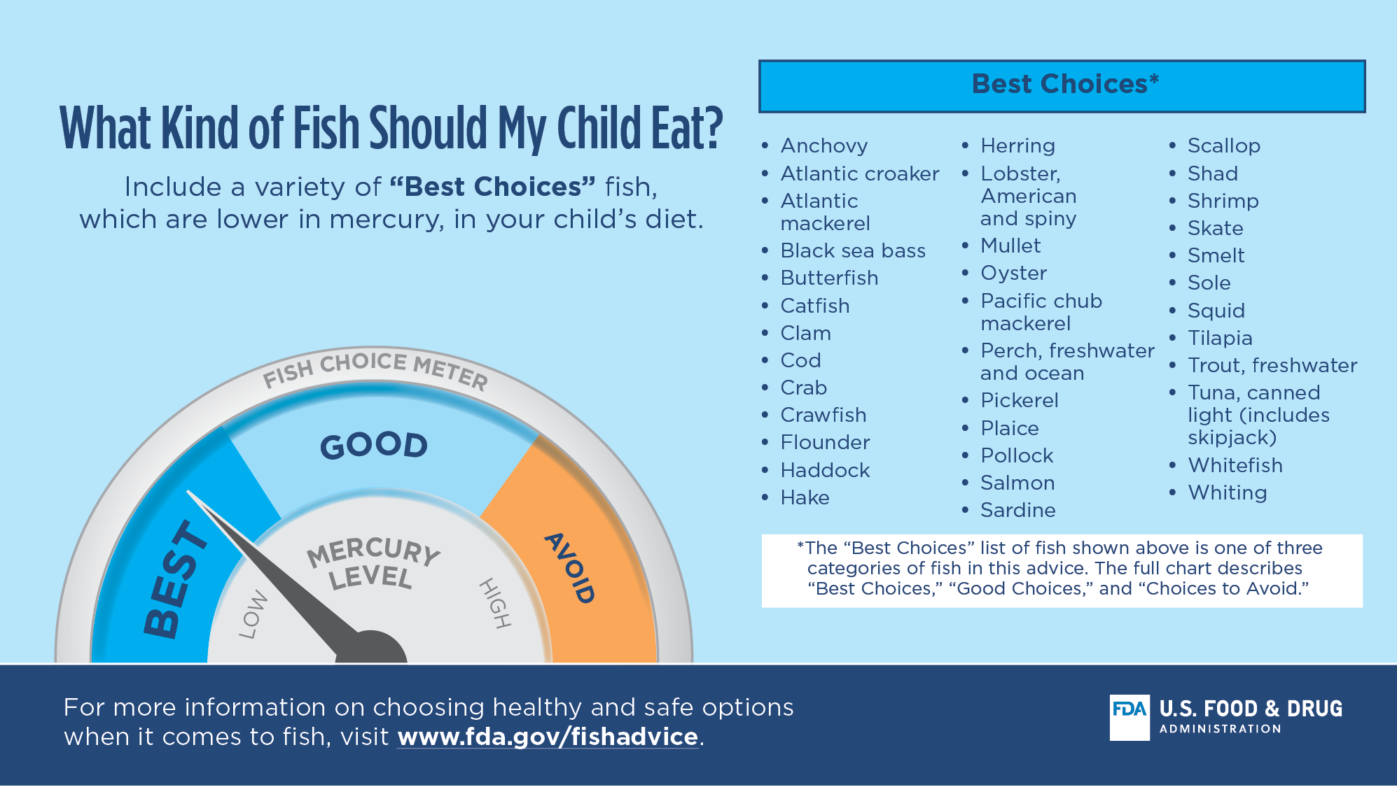
What Kind of Fish Should My Child Eat?
Include a variety of “Best Choices*” fish, which are lower in mercury, in your child’s diet.
Anchovy
Atlantic croaker
Atlantic mackerel
Black sea bass
Butterfish
Catfish
Clam
Cod
Crab
Crawfish
Flounder
Haddock
Hake
Herring
Lobster, American and spiny
Mullet
Oyster
Pacific chub mackerel
Perch, freshwater and ocean
Pickerel
Plaice
Pollock
Salmon
Sardine
Scallop
Shad
Shrimp
Skate
Smelt
Sole
Squid
Tilapia
Trout, freshwater
Tuna, canned light (includes skipjack)
Whitefish
Whiting
*The “Best Choices” list of fish shown above is one of three categories of fish in this advice. The full chart describes “Best Choices,” “Good Choices,” and “Choices to Avoid.”
For more information on choosing healthy and safe options when it comes to fish, visit www.fda.gov/fishadvice.
Notes:
While it is important to limit mercury in the diets of children, many types of fish are both nutritious and lower in mercury. FDA and EPA have created a chart to help you choose which fish to feed your child, and how often, based on their mercury levels.
When feeding your child, include a variety of “Best Choices” fish, which are lower in mercury, in your child’s diet.
The “Best Choices” list of fish shown in this slide is one of three categories of fish in FDA and EPA’s chart. The full chart describes “Best Choices,” “Good Choices” and “Choices to Avoid.”
For more information on choosing fish to help support child growth and development, visit www.fda.gov/fishadvice

