Slide 1
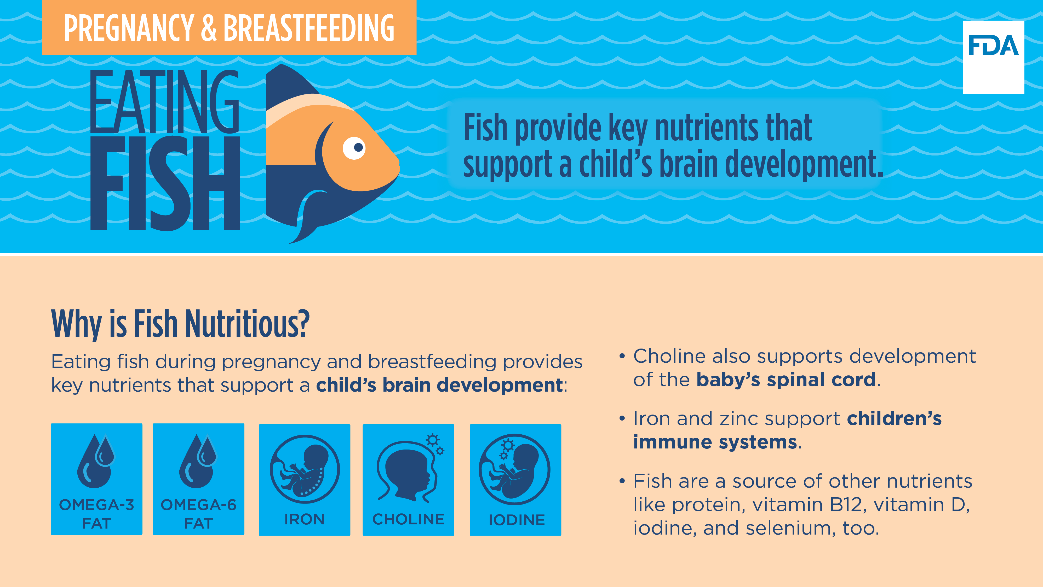
PREGNANCY & BREASTFEEDING EATING FISH
Fish provide key nutrients that support a child’s brain development.
Why is Fish Nutritious?
Eating fish during pregnancy and breastfeeding provides key nutrients that support a child’s brain development:
OMEGA-3 FAT
OMEGA-6 FAT
IRON - Iron and zinc support children’s immune systems.
CHOLINE - Choline also supports development of the baby’s spinal cord.
IODINE - Fish are a source of other nutrients like protein, vitamin B12, vitamin D, iodine, and selenium, too.
Notes:
FDA and EPA have issued advice regarding eating fish to help those who might become or are pregnant or breastfeeding as well as parents and caregivers who are feeding children make informed choices when it comes to the types of fish that are nutritious and safe to eat.
FDA recommends eating fish as part of a healthy diet and encourages children and people who are or might become pregnant or breastfeeding to eat fish that are lower in mercury.
Fish provides key nutrients such as omega-3 and omega-6 fats, iron, choline, and iodine (during pregnancy) to support a child’s brain development. Choline also supports development of the baby’s spinal cord and fish provides iron and zinc to support children’s immune systems. Fish are a source of other nutrients like protein, vitamin B12, vitamin D, and selenium too.

Slide 2
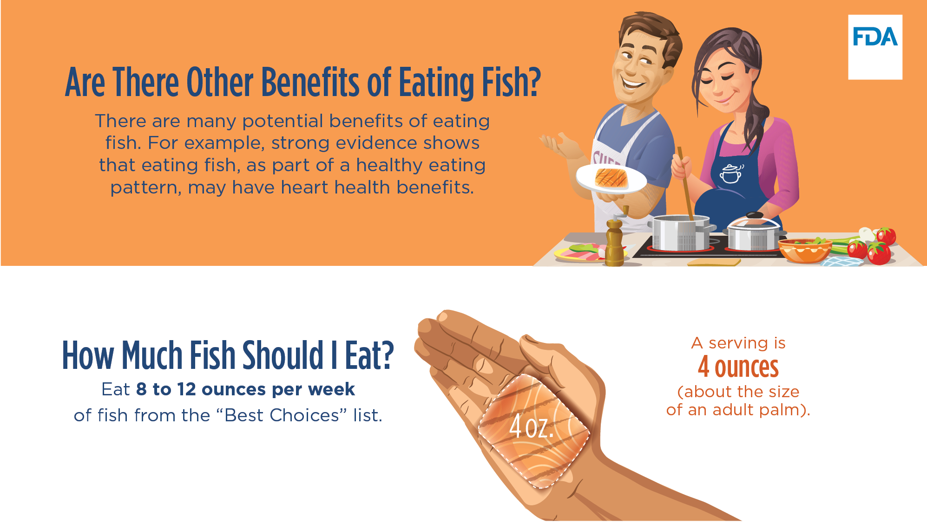
Are There Other Benefits of Eating Fish?
There are many potential benefits of eating fish. For example, strong evidence shows that eating fish, as part of a healthy eating pattern, may have heart health benefits.
How Much Fish Should I Eat?
A serving is 4 ounces (about the size of an adult palm).
Eat 8 to 12 ounces per week of fish from the “Best Choices” list.
Notes:
Strong evidence also shows that eating fish, as part of a healthy eating pattern, may have heart health benefits. Healthy eating patterns that include fish may have other benefits too.
Moderate scientific evidence shows that eating patterns relatively higher in fish but also in other foods, are associated with the promotion of bone health by decreasing the risk for hip fractures, decreasing the risk of becoming overweight or obese, and decreasing the risk for colon and rectal cancers. In addition to fish, these eating patterns also include vegetables, fruits, legumes, whole grains, low- or non- fat dairy, lean meats and poultry, nuts, and unsaturated vegetable oils, and are lower in red and processed meats, sugar-sweetened foods and beverages, and refined grains.
Those who are pregnant or breastfeeding should eat between 8 and 12 ounces of fish from FDA and EPA’s “Best Choices” list. This list will be provided on the next slide. A serving is 4 ounces (about the size of an adult palm).

Slide 3
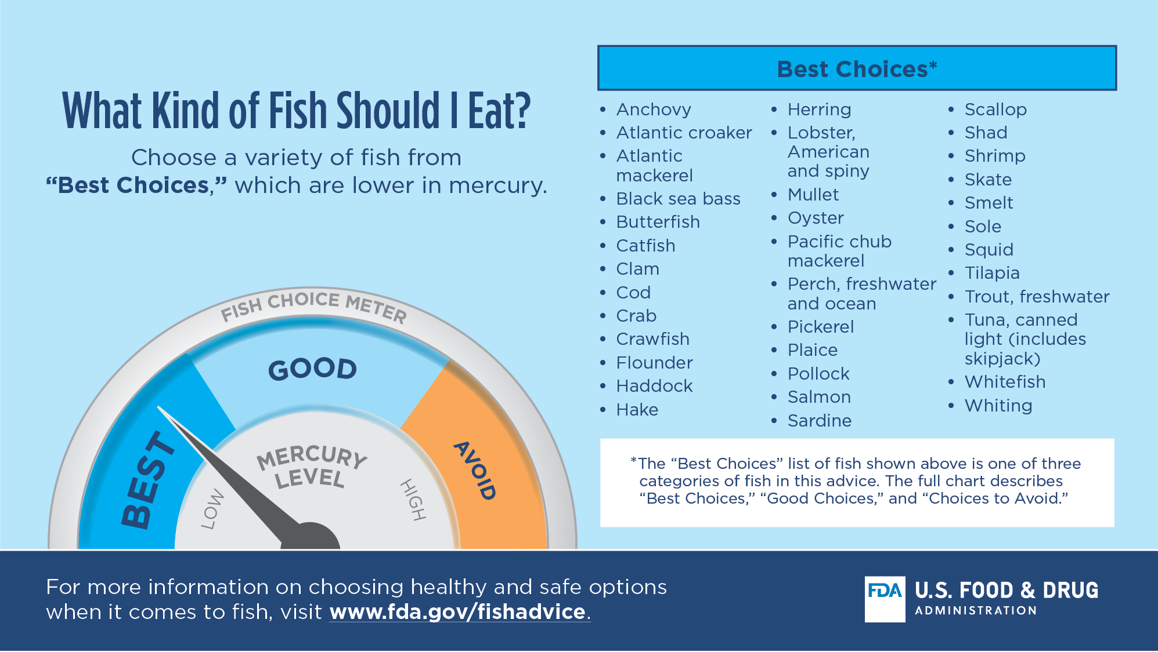
What Kind of Fish Should I Eat?
Choose a variety of fish from “Best Choices*,” which are lower in mercury.
Anchovy
Atlantic croaker
Atlantic mackerel
Black sea bass
Butterfish
Catfish
Clam
Cod
Crab
Crawfish
Flounder
Haddock
Hake
Herring
Lobster, American and spiny
Mullet
Oyster
Pacific chub mackerel
Perch, freshwater and ocean
Pickerel
Plaice
Pollock
Salmon
Sardine
Scallop
Shad
Shrimp
Skate
Smelt
Sole
Squid
Tilapia
Trout, freshwater
Tuna, canned light (includes skipjack)
Whitefish
Whiting
*The “Best Choices” list of fish shown above is one of three categories of fish in this advice. The full chart describes “Best Choices,” “Good Choices,” and “Choices to Avoid.”
For more information on choosing healthy and safe options when it comes to fish, visit www.fda.gov/fishadvice.
Notes:
While it is important to limit mercury in the diets of those who are pregnant or breastfeeding and children, many types of fish are both nutritious and lower in mercury. FDA and EPA have created a chart to help you choose which fish to eat, and how often to eat them, based on their mercury levels.
Choose a variety of fish from “Best Choices” fish, which are lower in mercury.
The “Best Choices” list of fish shown in this slide is one of three categories of fish in FDA and EPA’s chart. The full chart describes “Best Choices,” “Good Choices” and “Choices to Avoid.”
For more information on choosing healthy and safe options when it comes to fish, visit www.fda.gov/fishadvice

