Slide 1


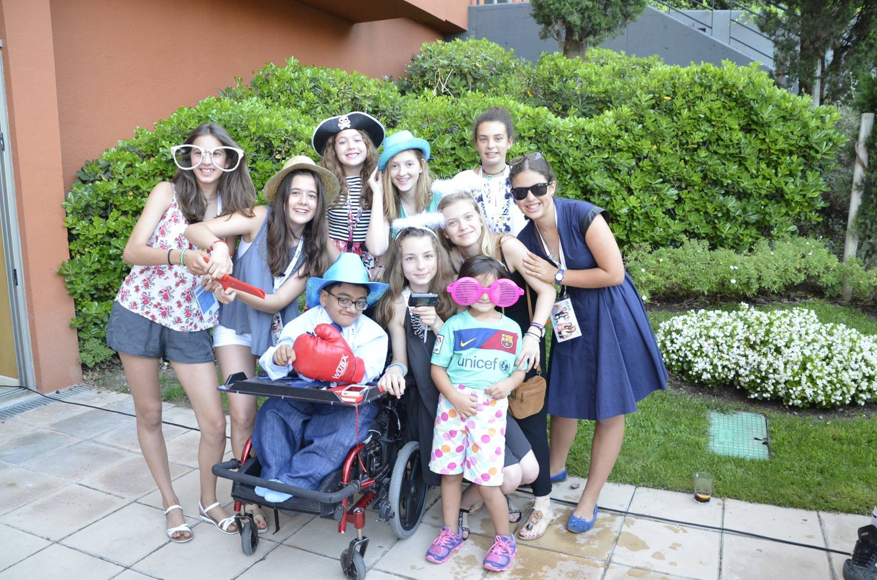



International Children’s Advisory Network
The iCAN Mission:
To foster greater global understanding about the importance of the pediatric patient and caregiver voice in healthcare, clinical trials, and research.
Nothing about kids, without the voice of kids.
Amy Ohmer
Director, iCAN
amyohmer@icanresearch.org
www.icanresearch.org

Slide 2

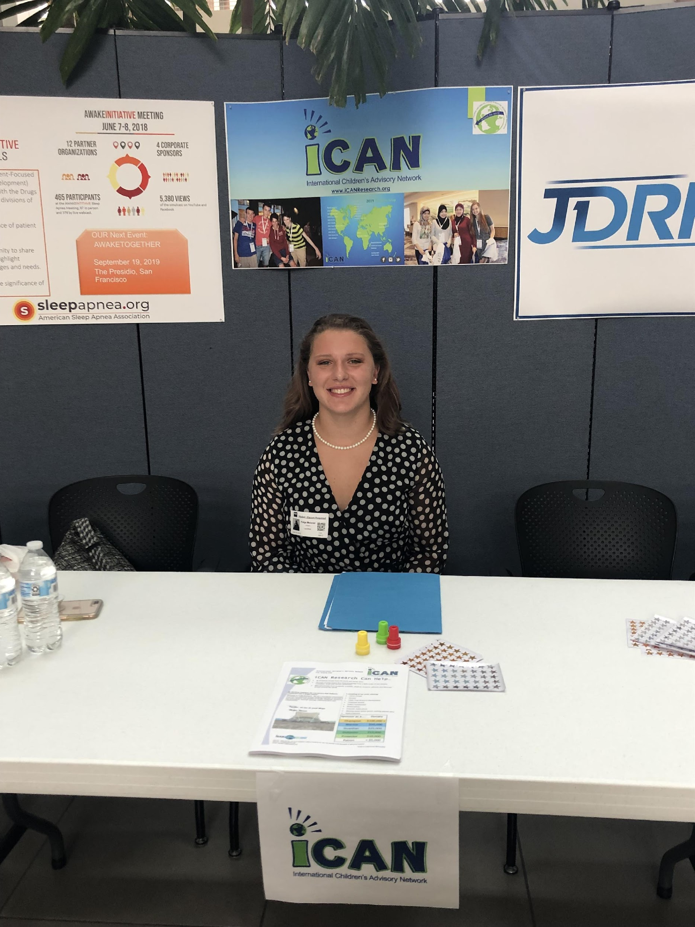
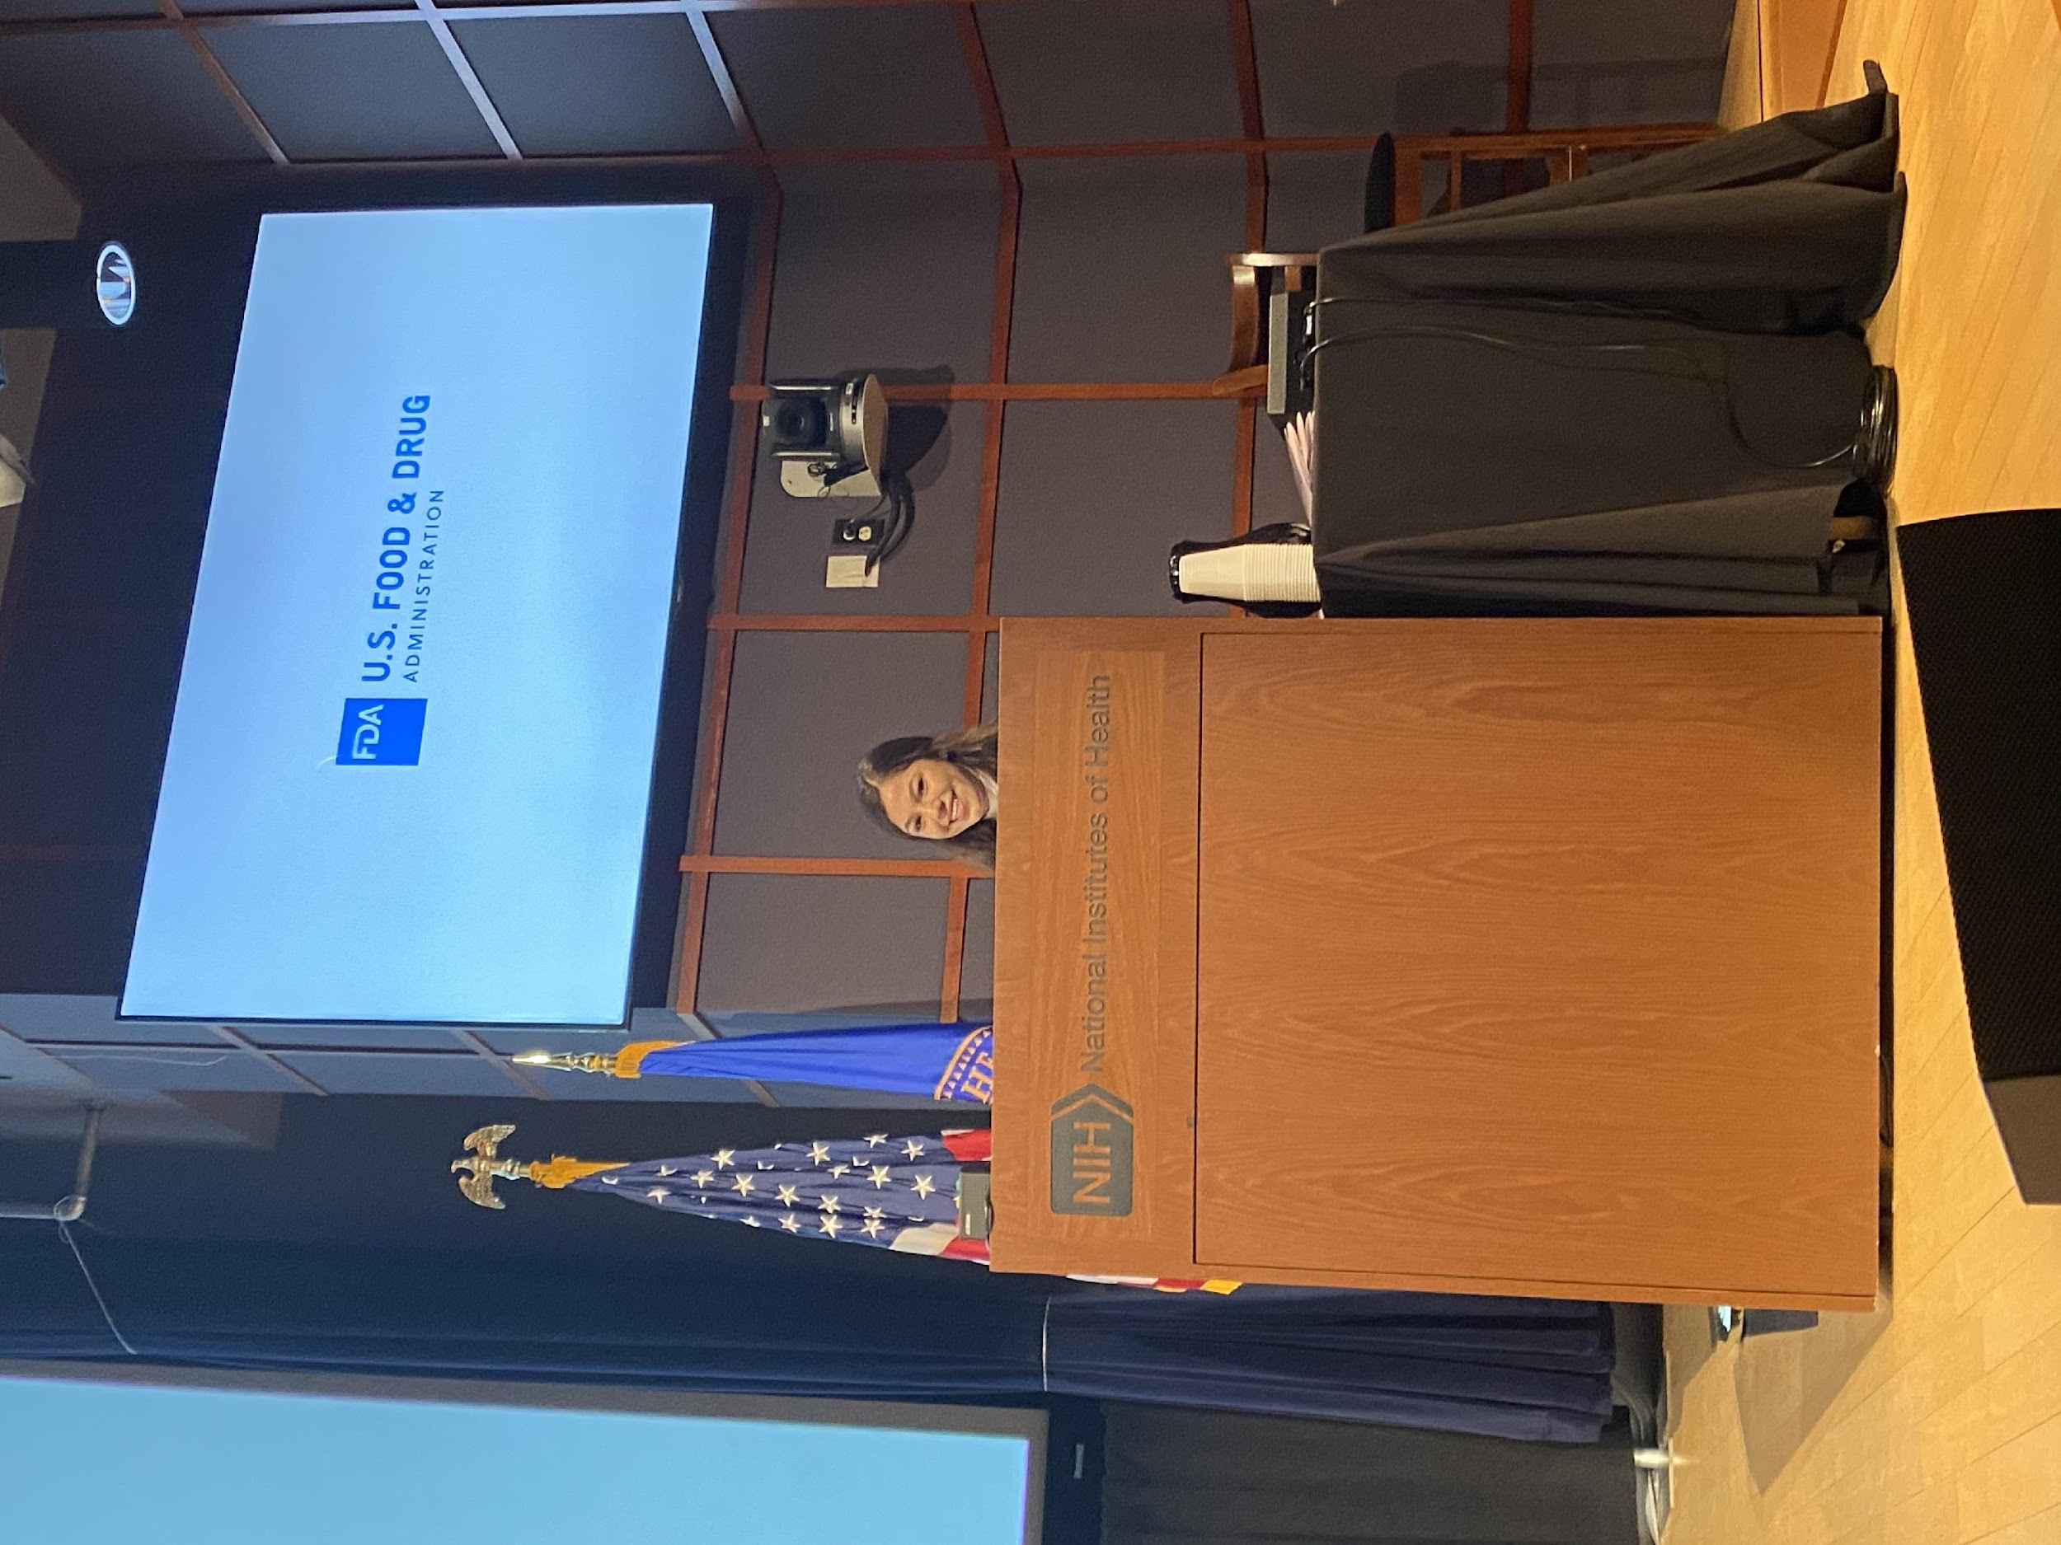

iCAN and FDA:
iCAN supports multiple channels of inclusion for children, young people, and parents.
Focus Groups
Speaking Opportunities
Surveys
Creative Communication (art, stories, and their own ideas)
Past Projects Include:
                Medical Device User Fee Amendments (MDUFA V)
                Patient Caregiver Connection Partner (PCC)
                Supporting The Future of Rare Disease, Town Hall, Rare Disease Day
                The Evolving Role of AI in Radiological Imaging
                ADEPT 6 Panel
                Office of Medical Device and Radiological Health OMDRHO
                Sharing the FDA on www.icanresearch.org

Slide 3
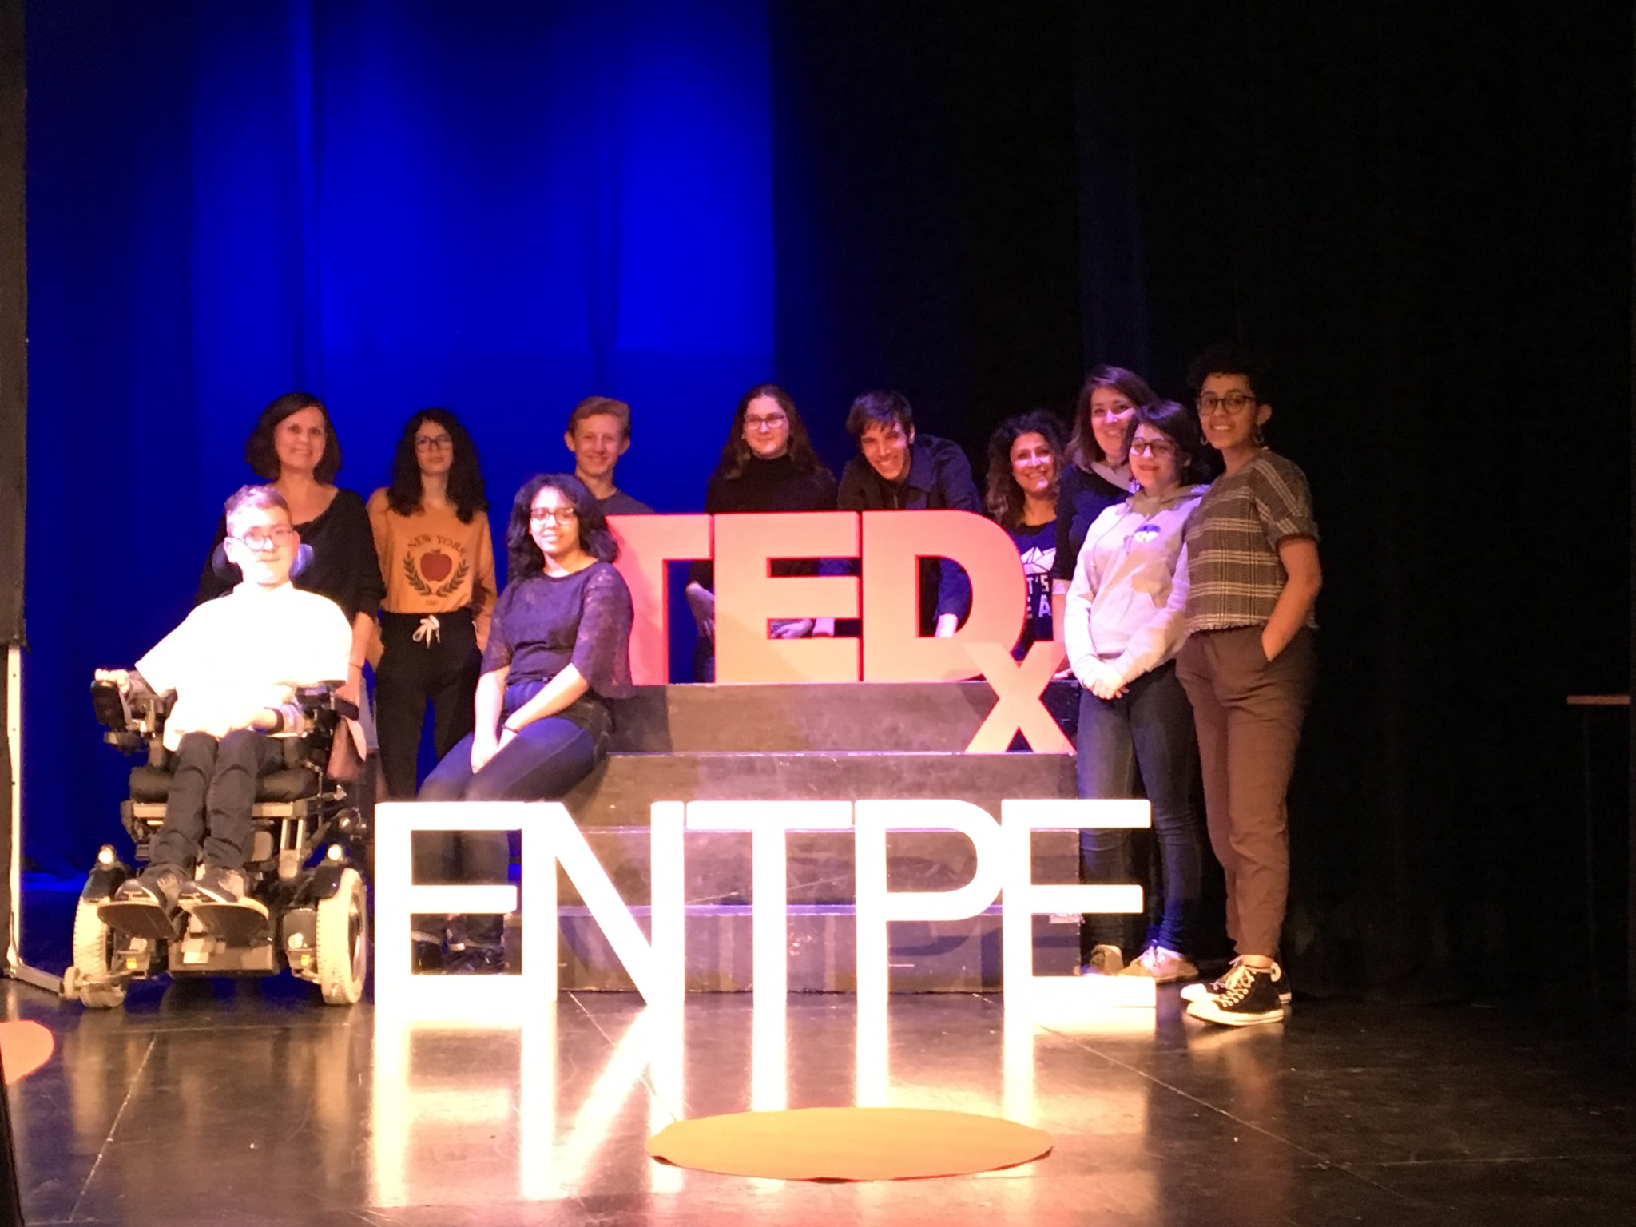
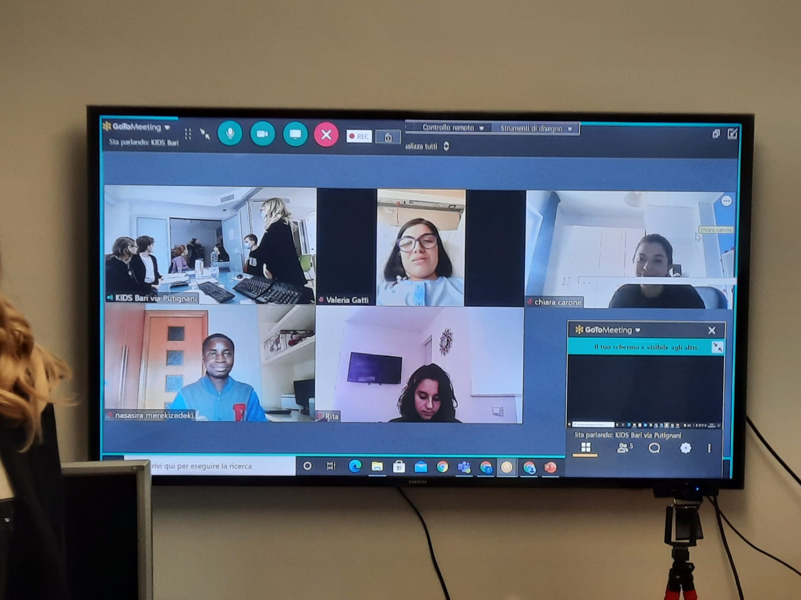
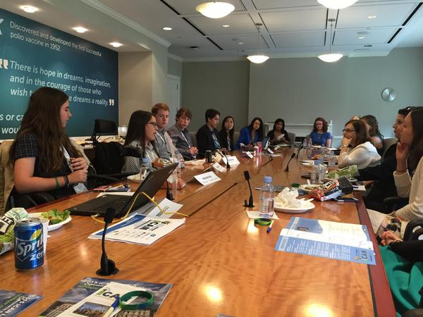
iCAN Recommends:
Practice Pediatric Patient Involvement:
  Include patient voice early on within all projects/reviews.
  Support feedback loop of patient review, changes, patient review.
  Meet children and young people where they are at by offering a variety of communication/participation methods.
  Support multiple language and reading abilities.
Learning Modules Designed with Community Partnership:
  2020 – Launched Telling Your Story
  2021 – Understanding Clinical Research
  2022 - Pepperdine University Good Communication Activity Video
  NEW in July, 2022 - Becoming a leader
  Ongoing - iCAN Ask the Experts

Slide 4


Thank you for supporting the voice of youth
Amy Ohmer
iCAN Director
AmyOhmer@iCANResearch.org
www.icanresearch.org
Upcoming Pediatric Patient Engagement Opportunity:
2022 iCAN Summit presented by Jumo Health
July 11th – July 15th, 2022, in Lyon, France
Register today!
www.icanresearch.org/2022-summit

